Slide 1
A Quick Introduction to Processing
Ira Greenberg,
Deepak Kumar,
Dianna Xu
Darby Thompson Aaron Cadle
Ursula Wolz

Slide 2
Web Sites
www.processing.org
www.openprocessing.org

Slide 3
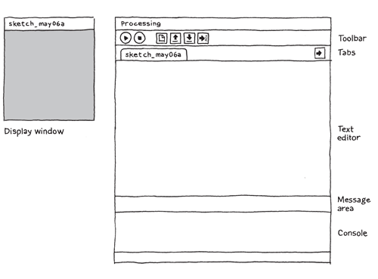
The Processing IDE

Slide 4
Hello, World!, V1
line(15, 25, 70, 90);
X1, y1, X2, Y2

Slide 5
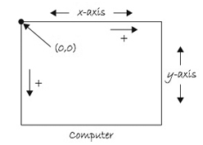
Coordinate System

Slide 6
Hello, World!, V1.1
size(400, 400); // 0..width-1 x 0..height-1
background(192, 64, 0); // rgb values
stroke(255); // monochrome 0..255
line(150, 25, 270, 350);

Slide 7
Hello, mouse!
void setup() {
size(400, 400);
stroke(255);
background(192, 64, 0);
}
void draw() {
line(150, 25, mouseX, mouseY);
}

Slide 8
Static vs. Active Program Modes
// declarations
void setup() {
// initial setup
// size, smoothing
// frame rate
// etc
}
void draw() {
// the stuff that loops
//at frame rate
}
size(X, Y);
size(X, Y, JAVA2D/P2D/P3D/OPENGL); smooth(); frameRate(n); etc.

Slide 9
Mouse Events
void mousePressed () {
do something
}
void mouseDragged () {
do something
}
// Lots more mouse methods
// and keyboard too

Slide 10
Try
void setup() {
size(400, 400);
stroke(255);
background(192, 64, 0);
}
void draw() {
// nothing here
}
void mousePressed(){
line(150, 25, mouseX, mouseY);
}

Slide 11
Try, V2
void setup() {
size(400, 400);
stroke(255);
}
void draw() {
background(192, 64, 0);
}
void mousePressed(){
line(150, 25, mouseX, mouseY);
}

Slide 12
Exercise 1
Whenever mouse is pressed and dragged, draw lines from mouse location to the four corners of the screen.
Hints:
Upper left corner is 0,0
Lower right corner is width, height
mouseX and mouseY
Nothing will draw unless you override ‘draw’
You will need to override ‘mouseDragged()

Slide 13
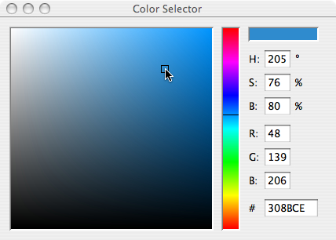
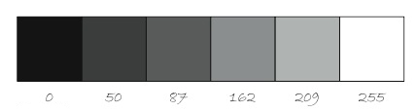
Basic shapes, strokes, color
point(x, y);
line(x1, y1, x2, y2); triangle(x1, y1, x2, y2, x3, y3);
rect(Xtopleft, Ytopleft, W, H);
quad(x1, y1, … , x4, y4);
ellipse(Xcenter, Ycenter, W, H);
stroke(R, G, B); noStroke();
strokeWeight(n);
fill(R, G, B);
noFill();

Slide 14
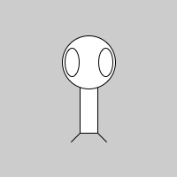
Example 1
size(200,200);
rectMode(CENTER);
rect(100,100,20,100);
ellipse(100,70,60,60);
ellipse(81,70,16,32);
ellipse(119,70,16,32);
line(90,150,80,160);
line(110,150,120,160);

Slide 15
Example 2
int x, y;
void setup() {
size(400, 400);
smooth();
x = 0;
y = height/2;
}
void draw() {
background(255);
fill(255, 0, 0);
stroke(255, 0, 0);
ellipse(x, y, 50, 50);
x++;
}
Draw a red ball and make it move
across the screen.
Add to setup:
frameRate(10);

Slide 16
Exercise 2
Extend to:
Vary both x and y coordinates.
Ensure the ball stays within bounds.

Slide 17

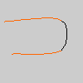
Arcs & Curves
arc(x, y, width, height, start, stop);
start, stop are angles in radians 0 is due east angles increase in clockwise direction
curve(x1, y1, x2, y2, x3, y3, x4, y4);
x1, y1 and x4, y4 are anchor points

Slide 18

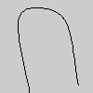
More Shapes
beginShape(); vertex(30, 20); vertex(85, 20); vertex(85, 75); vertex(30, 75); endShape(CLOSE);
noFill(); beginShape(); curveVertex(84, 91); curveVertex(84, 91); curveVertex(68, 19); curveVertex(21, 17); curveVertex(32, 100); curveVertex(32, 100); endShape();

Slide 19
Images
// Declaring a variable of type Pimage
// Where you put the image depends on your OS (sigh)
// You can link to images on the internet.
PImage img;
void setup() {
size(320,240);
// Make a new instance of a PImage by loading an image file
img = loadImage("mysummervacation.jpg");
}
void draw() {
background(0);
// Draw the image to the screen at coordinate (0,0)
image(img,0,0);
}

Slide 20
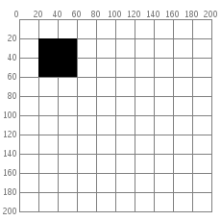
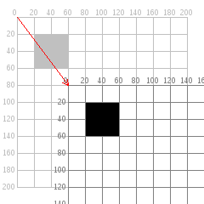
2-D Transformations translate(x, y)
fill(0); translate(60, 80); rect(20, 20, 40, 40);
fill(0); rect(20, 20, 40, 40);

Slide 21
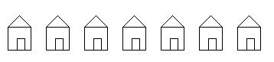
push/pop Matrix
void house(int x, int y) { pushMatrix(); translate(x, y); triangle(15, 0, 0, 15, 30, 15); rect(0, 15, 30, 30); rect(12, 30, 10, 15); popMatrix(); }
for (int i = 10; i < 350; i = i + 50) { house(i, 20); }

Slide 22
Where Can This Take You
Montclair Code Community: Parent & Daughter
Jade who is in 5th grade wanted to draw a petal
Eli and Rowan, assistant coaches stumbled on a Beizer curve
Jane, another assistant started experimenting with curves.
Jade’s dad John wanted to show Jade how to use a four loop, but got hung up on rotate/radians (we are not fond of PI)
Ursula created a petal procedure
Ursula was inspired by Charlie Ortmans (UU) sermon on how flowers represent beauty.
Ursula, Jade, John and Rowan presented Charlie with a retirement present.

Slide 23
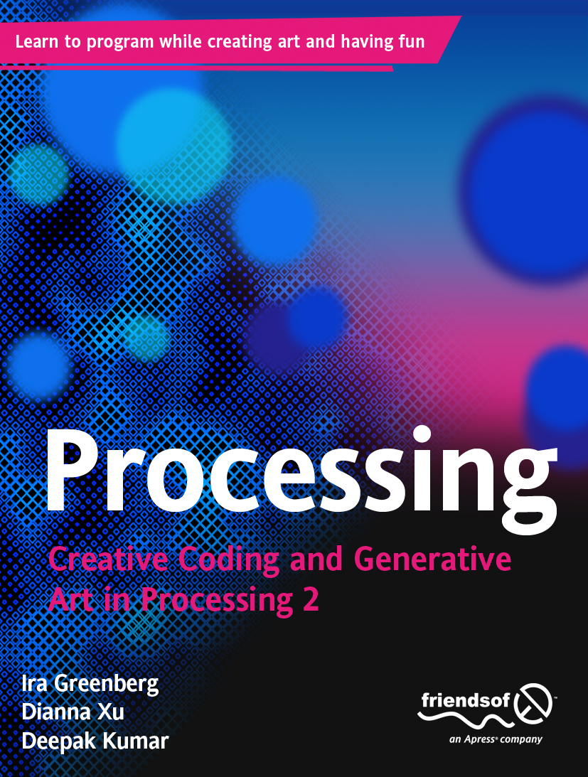

Slide 24
Web Sites
cs.brynmawr.edu/content/processing
www.processing.org
www.openprocessing.org

